Slide 1

IT2060
Operating Systems and System Administration
Lecture 06
UNIX Commands &
Shell Programming

Slide 2
Shell Programming
Variables
  Can be set by giving the character strings of the form
    name=value
  Can be displayed by
    $ echo $name
  Examples
    $ name=sunil
    $ echo $name
    Sunil
  echo command – prints on the screen – a good debugging tool

Slide 3
Shell Programming
Exporting Variables
  To make them available for subshells
  Syntax:
    $ OS=Linux
    $ export OS
  Use bash command to create a subshell and access variable created in parent shell
  Use Ctrl +D to come back to previous shell
  How can we see environment variables?
    Use env
  How can we see all variables?
    Use set

Slide 4
Arithmetic Operations in Shell Programming
Arithmetic Expressions
  Limited support in bash
    Ex
    $ num=3
    $ echo $num + 2
    3 + 2
  Can be performed by expr utility
    Ex
    $ echo `expr $num + 2`
    5

Slide 5
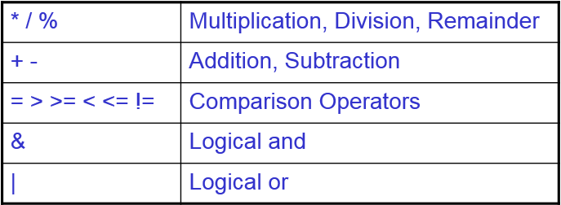
Arithmetic Operations in Shell Programming
Arithmetic Expressions
  Operators
  Parenthesis can be used to control the order of evaluation
    Ex
    $ echo `expr \( 2 + 3 \) \* 5`

Slide 6
Interactive shell scripts
    read command
A common task in shell scripts is to prompt for users input and then read their responses
To do this, use the read command to set the value of a variable
It reads the entire line of user input and makes it the value of the variable specified
Ex:
echo “Enter your name please:”
read fname lname
echo “Hello $fname $lname, Lets be friend!”

Slide 7
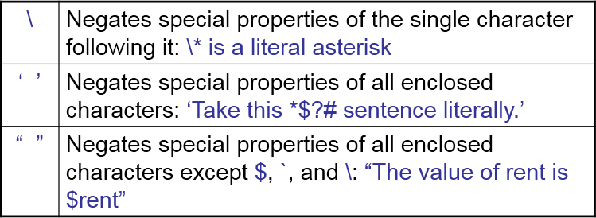
    Neutralizing Meta characters
.
Unix supports escape mechanisms to print messages with meta characters

Slide 8
    Shell Script Arguments: Positional Parameters
Inside shell scripts, arguments can be referred by number assigned to its position.
  shell script $*
  show me the way
  $0 $1 $2 $3
  S# - Number of positional parameters
  $* - List of all arguments, can’t yield each arguments separately when enclosed in double quotes
  $@ - List of all arguments, yields each argument separately when enclosed in double quotes

Slide 9
    Example: testPara
#!/bin/bash
echo “Total command line arguments:$#”
echo “$0 is script name”
echo “$1 is first argument”
echo “$2 is second argument”
echo “All of them are: $* or $@”
$./testPara Hello World
Total command line arguments:2
./testPara is script name
Hello is first argument
World is second argument
All of them are: Hello World or Hello World

Slide 10
    Special Shell Variables
$? –The exit status of the last executed command
$$ – The process number (PID) of the current shell
$! – The process number (PID) of the last background command

Slide 11
Exit Command
  exit command
exit command does two things
  terminates the script
  gives exit status of script
exit status 0 implies success
Non-zero values can be used to signify different errors in called program
Error messages tell the user what is wrong, but the exit status can be used by other programs

Slide 12
Decision making in shell scripts
Always, decision making is based on true or false
That can be performed using,
test command or [ expr ]
  If true → return zero
  Otherwise → returns nonzero
  Syntax:
  test expression OR [ expression ]

Slide 13
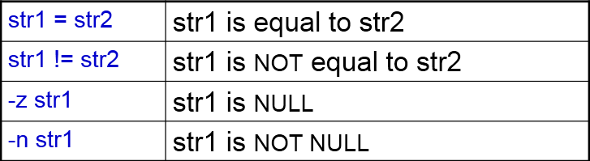
String Comparison in Shell
  String comparisons:
  str1 operator str2
      str1 and str2 are character strings
  Operators:

Slide 14
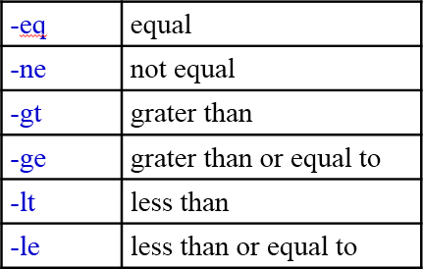
Numerical Comparison in Shell
  Number comparisons:
    int1 operator int2
      int1 and int2 are integers
  Operators:

Slide 15
test command
  Examples
    String comparison
      $ day=`date | cut –f1 –d “ ”`
      $ test “$day” = “Tue”
    Integer comparison
      $ stop=0
      $ test $stop –eq 0

Slide 16
IF Statements
Example
if [ $# -eq 0 ]
then
echo “$0 :You must supply one integer”
exit 1
fi
Run the script with a integer parameter and with out parameter
Check exit status
    $ echo $?

Slide 17
IF…ELSE…FI
if …else…fi: Example
  #!/bin/bash
  #
  # Script to see whether argument is positive or negative
  #
  if test $1 -gt 0
  then
  echo “$1 :number is positive”
  else
  echo “$1 :number is negative ”
  fi
Run the example
$./demo 5

Slide 18
Nested IF Statements
  Nested if…else…fi: Example
  #!/bin/bash
  osch=0
  echo “1. Unix (Sun Os)”
  echo “2. Linux (Red Hat)”
  echo -n “Select your os choice [1 or 2]?”
  read osch
  if [ $osch -eq 1 ] ; then
  echo “You Pick up Unix (Sun Os)”
  else ### nested if i.e. if within if ###
  if [ $osch -eq 2 ] ; then
  echo “You Pick up Linux (Red Hat)”
  else
  echo “Don't you like Unix/Linux OS.”
  fi
  fi

Slide 19
Multilevel if…then…else: Example
if [ $number –lt 0 ]
    then
    echo negative
    elif [ $number –eq 0 ]
    then
    echo zero
    else
    echo positive
    fi

Slide 20
Case Statements
case …in…esac: Example1
    case $day in
    “Sun” )
    echo Sunday
    ;;
    “Mon” | “Tue” | “Wed” | “Thu” | “Fri” )
    echo Weekday
    ;;
    “Sat” )
    echo Saturday
    ;;
    esac

Slide 21
Looping Structures
for…do…done: Syntax1
    for variable-name in list
    do
    commands …
    done
    execute once for each item in the list and repeat all statement between do and done

Slide 22
FOR Loops
for…do…done: Example
for num in 1 2 3 4 5
do
    echo This is loop $num
    done
Output:
This is loop 1
This is loop 2
This is loop 3
This is loop 4
This is loop 5

Slide 23
FOR Loops
for…do…done: Syntax2
    for (( expr1; expr2; expr3 ))
    do
    commands….
    done
    Repeat all statements between do and done until expr2 is TRUE
for (( i = 0 ; i <= 5; i++ ))
do
    echo This is loop $i
    done

Slide 24
Nested- FOR Loops
Nesting of for loops: Example
for (( i = 1; i <= 5; i++ )) ### Outer for loop ###
do
for (( j = 1 ; j <= 5; j++ )) ### Inner for loop ###
do
echo -n “$i ”
done
echo “” #### print the new line ###
done
Output
1 1 1 1 1
2 2 2 2 2
3 3 3 3 3
4 4 4 4 4
5 5 5 5 5

Slide 25
WHILE Loops
while…do…done: Syntax
    while [conditional_expression ]
    do
      Commands…
    done
    Repeat commands within do and done if condition is satisfied

Slide 26
WHILE Loops
Output
This is loop 0
This is loop 1
This is loop 2
This is loop 3
This is loop 4
This is loop 5
while…do…done: Example
num=0
    while test $num –le 5
    do
    echo This is loop $num
    num=`expr $num + 1`
    done

Slide 27
UNTIL Loops
until…do…done: Syntax
    until conditional_expression
    do
      commands
    done
    Repeats as long as expression is false

Slide 28
UNTIL Loops
Output
This is loop 0
This is loop 1
This is loop 2
This is loop 3
This is loop 4
This is loop 5
until…do…done: Example1
    num=0
    until test $num –gt 5
    do
    echo This is loop $num
    num=`expr $num + 1`
    done
  The termination condition is reversed in until loop

Slide 29
Functions
Function performs particular activity in shell
  Syntax:
    function-name ( )
    {
    command ...
    return
    }

Slide 30
Example:
Type the following script in the prompt.
HelloUsr()
{
echo “Hello $LOGNAME, Have a nice day!”
return
}
To execute this HelloUsr() function just type its name in the prompt:
$ HelloUsr
Hello student, Have a nice day!

Slide 31
Passing Parameters to function
Example: printPara
printPara ()
{
echo “First parameter to function $1”
echo “Second parameter to function $2”
}
echo “First parameter to script $1”
echo “Second parameter to script $2”
printPara hello world

Slide 32
Save your script as printPara
Run it, $./printPara One Two
First parameter to script One
Second parameter to script Two
First parameter to function hello
Second parameter to function world

Slide 33
End of Lecture 7

